Slide 1
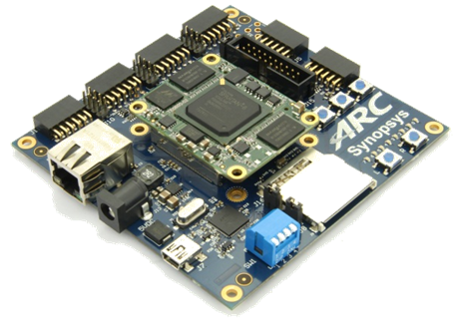
領先創新·
·超越自我
2019 Synopsys ARC盃電子設計競賽

Slide 2
iRobot – Robot System for Front-Vehicle Detection to Enhance Driver's Awareness
Team: Magical Robot
Tsang-Yung Wu, Wen-Cong Huang, Kai-Wen Yang
2019.08.27

Slide 3
Agenda
Introduction
Technology Breakthrough
Results
Conclusion
References
Appendix

Slide 4
Agenda
Introduction
Technology Breakthrough
Results
Conclusion
References
Appendix

Slide 5
Motivation – 3A
Augmented Reality
Understand the World
AIoT
ARC IoTdk
Connect the World
Compute the World

Slide 6
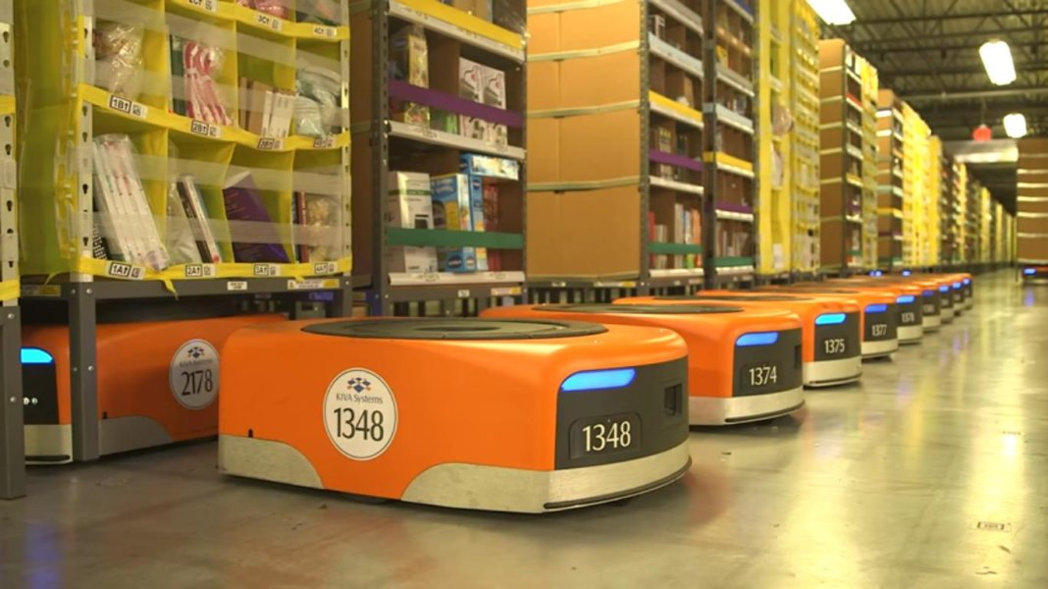
Prospect
Start
Think
Goal
Motivation –
3A
Front-Vehicle Detection
Smart Movement Robot
How to produce something interesting?
Urban scenes is easier to get, e.g. CityScapes
Like Amazon robot that move around warehouse smartly

Slide 7
System Architecture
Notes:
Prototype
Car with two wheels in the back one 導向輪 in the front
Car with ARC and self and Arduino on it
OV7670 is connected with the ARC and resting on the shelf
Bluetooth and a motor board are connected with the Arduino
LCD screen
More Specific Application Goal
Difference between segmentation and objection detection
Micro robot

Slide 8
Agenda
Introduction
Technology Breakthrough
Results
Conclusion
References
Appendix
Notes:
1. how performance changes
2. Testing results or training results
3. why demo looks bad (or good)

Slide 9
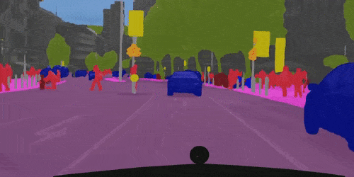
Technology Intro
Semantic
Segmentation
Figure referred from https://towardsdatascience.com/semantic-segmentation-popular-architectures-dff0a75f39d0
Notes:
理解場景->語意分割
例子：自駕車

Slide 10
Technology Breakthrough
The task of classifying each and very pixel in an image into different classes as shown in figure below
Example Use Cases
Self-Driving Cars
Robotic Systems
Damage Detection
Current Implementation
Traditional feature extraction
Deep learning
ICNet
Revised ICNet
ResNet
Final Model
Paper result
reproduce
Experiments & Revision
Hardware Constraint ??

Slide 11
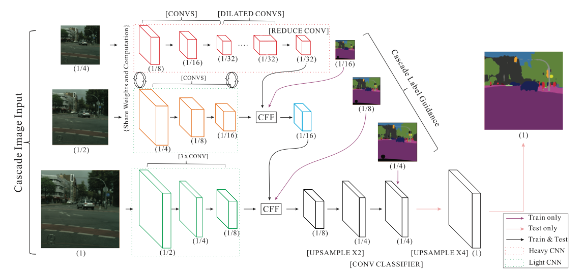
Method
Revised ICNet
ResNet
Final Model
The task of classifying each and very pixel in an image into different classes as shown in figure below
Example Use Cases
Self-Driving Cars
Robotic Systems
Damage Detection
Current Implementation
Traditional feature extraction
Deep learning
ICNet

Slide 12
Method
The task of classifying each and very pixel in an image into different classes as shown in figure below
Example Use Cases
Self-Driving Cars
Robotic Systems
Damage Detection
Current Implementation
Traditional feature extraction
Deep learning
ICNet
ResNet
Final Model
Revised ICNet

Slide 13
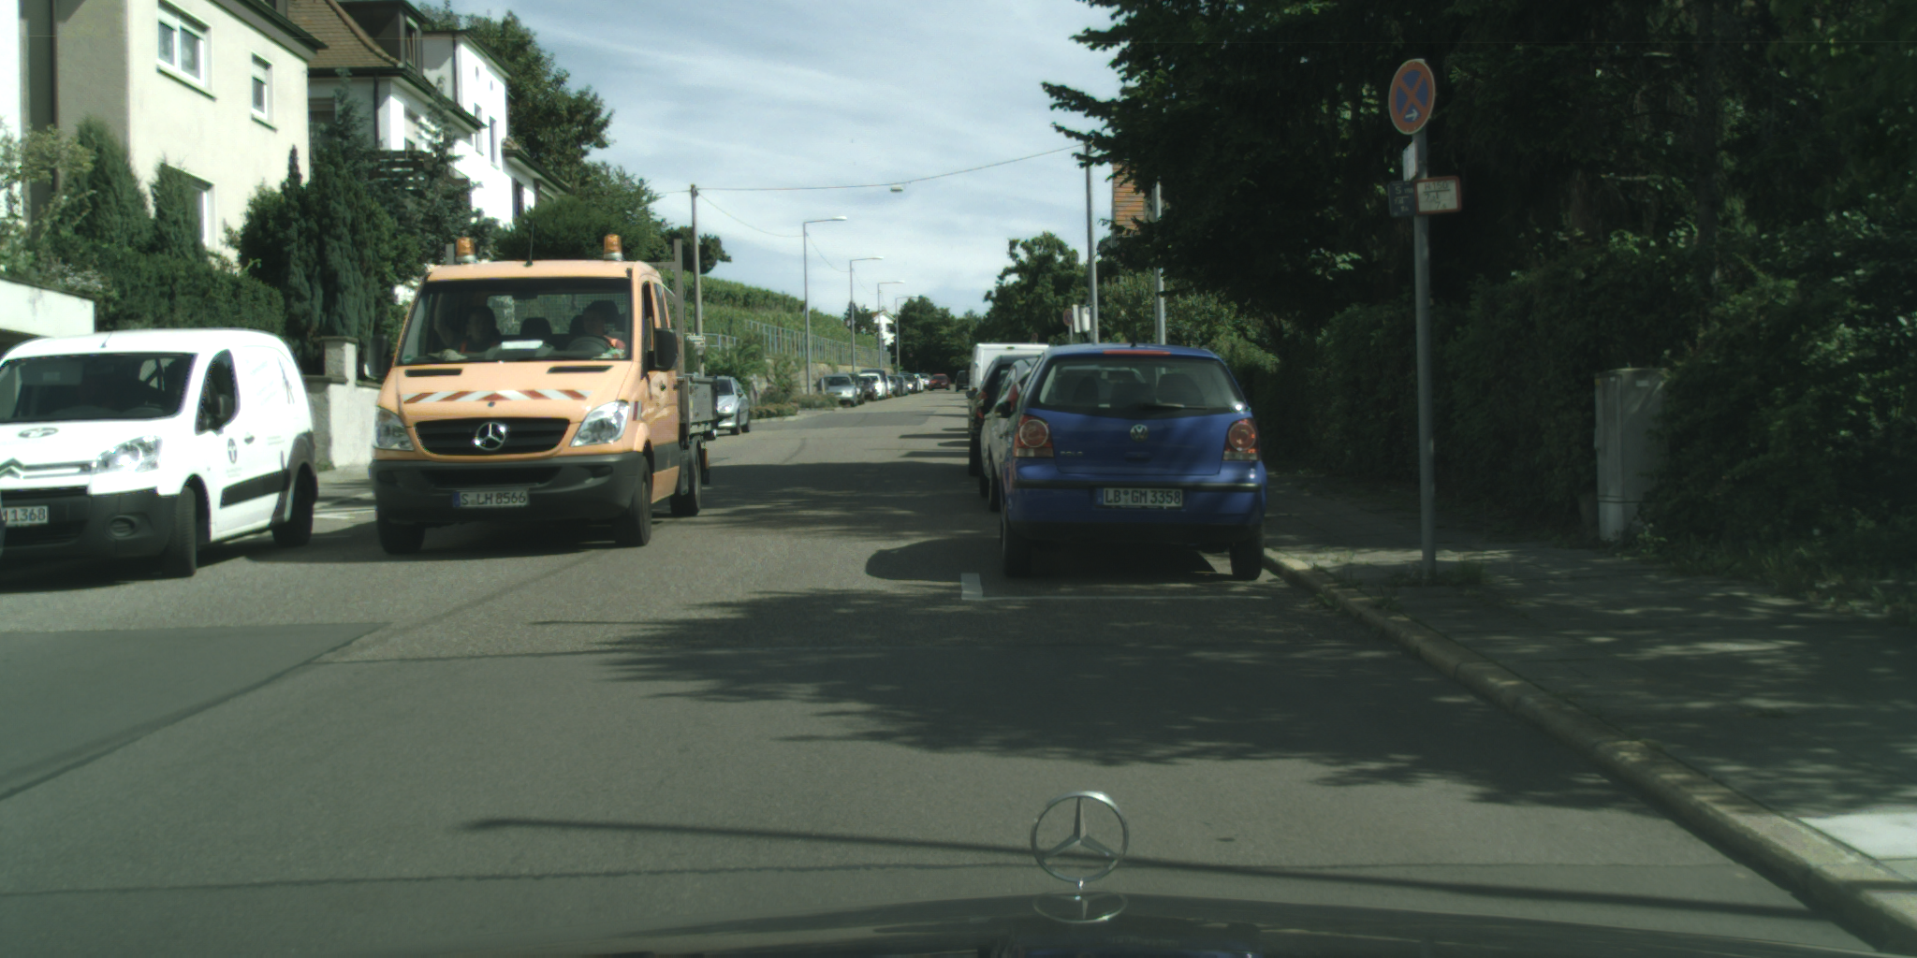
Method
ICNet
Revised ICNet
The task of classifying each and very pixel in an image into different classes as shown in figure below
Example Use Cases
Self-Driving Cars
Robotic Systems
Damage Detection
Current Implementation
Traditional feature extraction
Deep learning
Final
Model
ResNet
2
key classes
19 classes
Reshape input image to much smaller size
Shrink the numbers of channel in convolutional layers
Reduce number of class to 2 most important classes
Notes:
Revised icnet 依舊複雜 有限的memory情況下選擇使用resnet 並對resnet修改使成為

Slide 14
Model Feature
ICNet
Revised ICNet
ResNet
Final Model
Model Size
523KB
2054fps
Paper Result
Mode Size:
7MB
Input image size:
1024 x 2048
mIoU for all classes:
69.5%
Frame:
30fps
800fps
Frame
Rate
113KB
425fps
28KB

Slide 15
Model Feature
ICNet
Revised ICNet
ResNet
Final Model
81.6%
mIoU for Two Key Classes
79.4%
72.4%

Slide 16
Agenda
Introduction
Technology Breakthrough
Results
Conclusion
References
Appendix

Slide 17
Segmentation Results on GPU
Cityscapes testing image
Segmentation result
Cityscapes testing image
Segmentation result

Slide 18
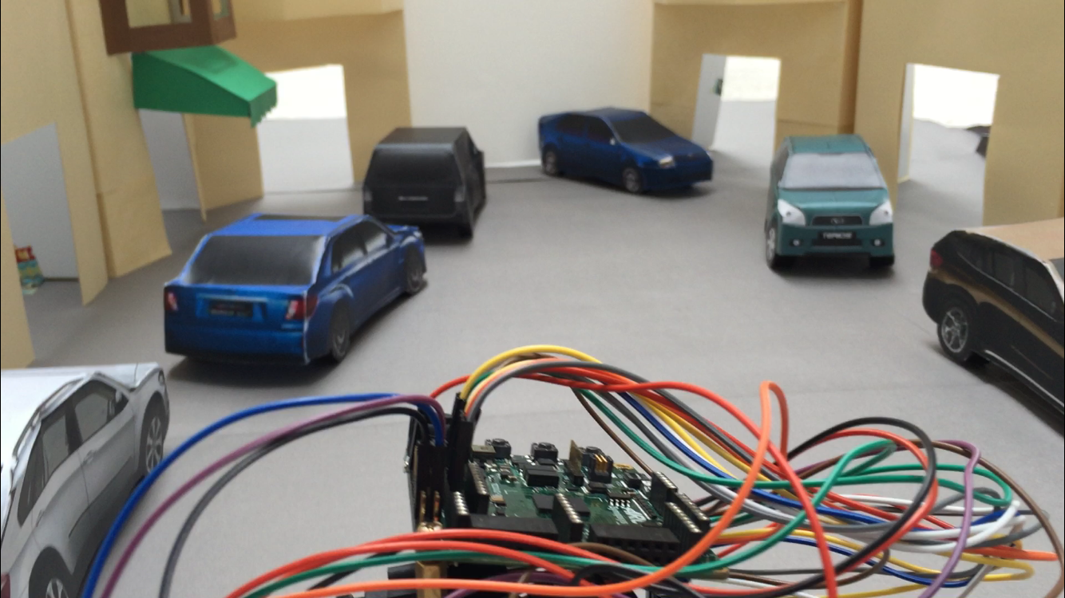
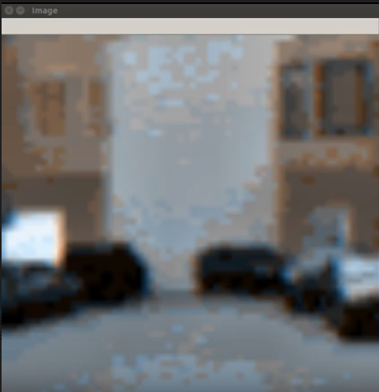
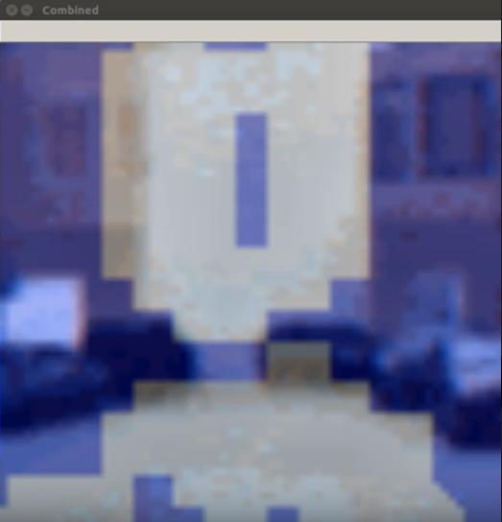
Segmentation Results on ARC
Simulative scene
Camera result
segmentation result
Notes:
Considering the data memory requirement, it is still impossible to download ICNet into the ARC board
Icnet actual size
Revisement you do to the ICNET
Later unfeasible reason the revised ICNet model size

Slide 19
Scene Understanding – How many cars?

Slide 20
Scene Understanding – Danger Detection

Slide 21
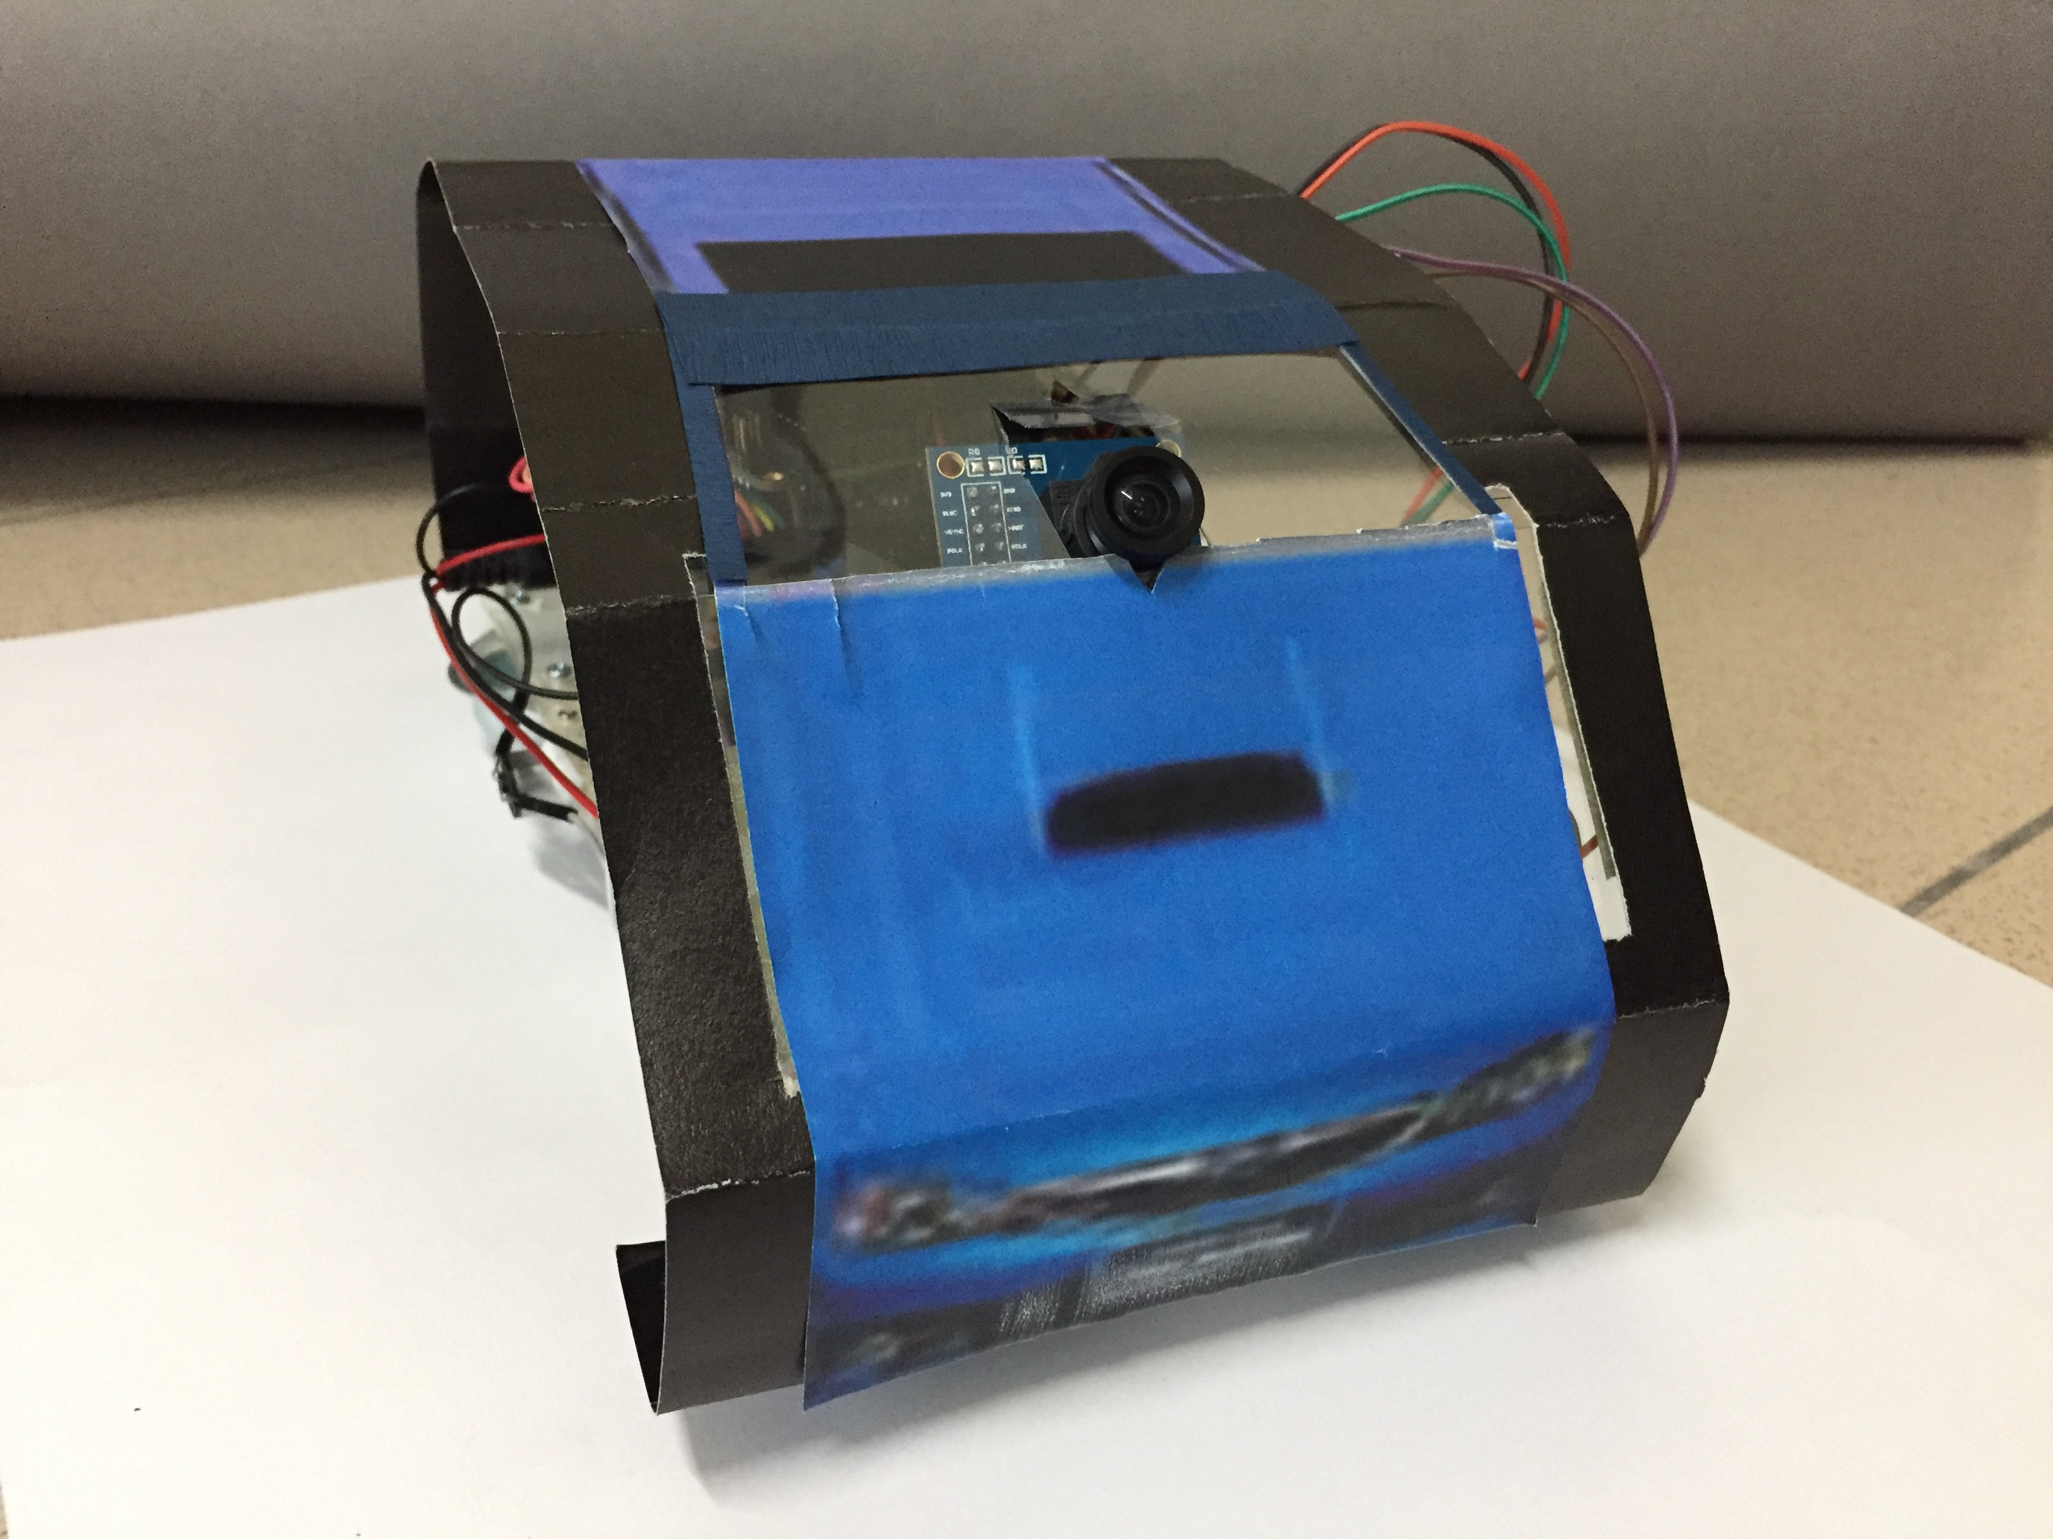
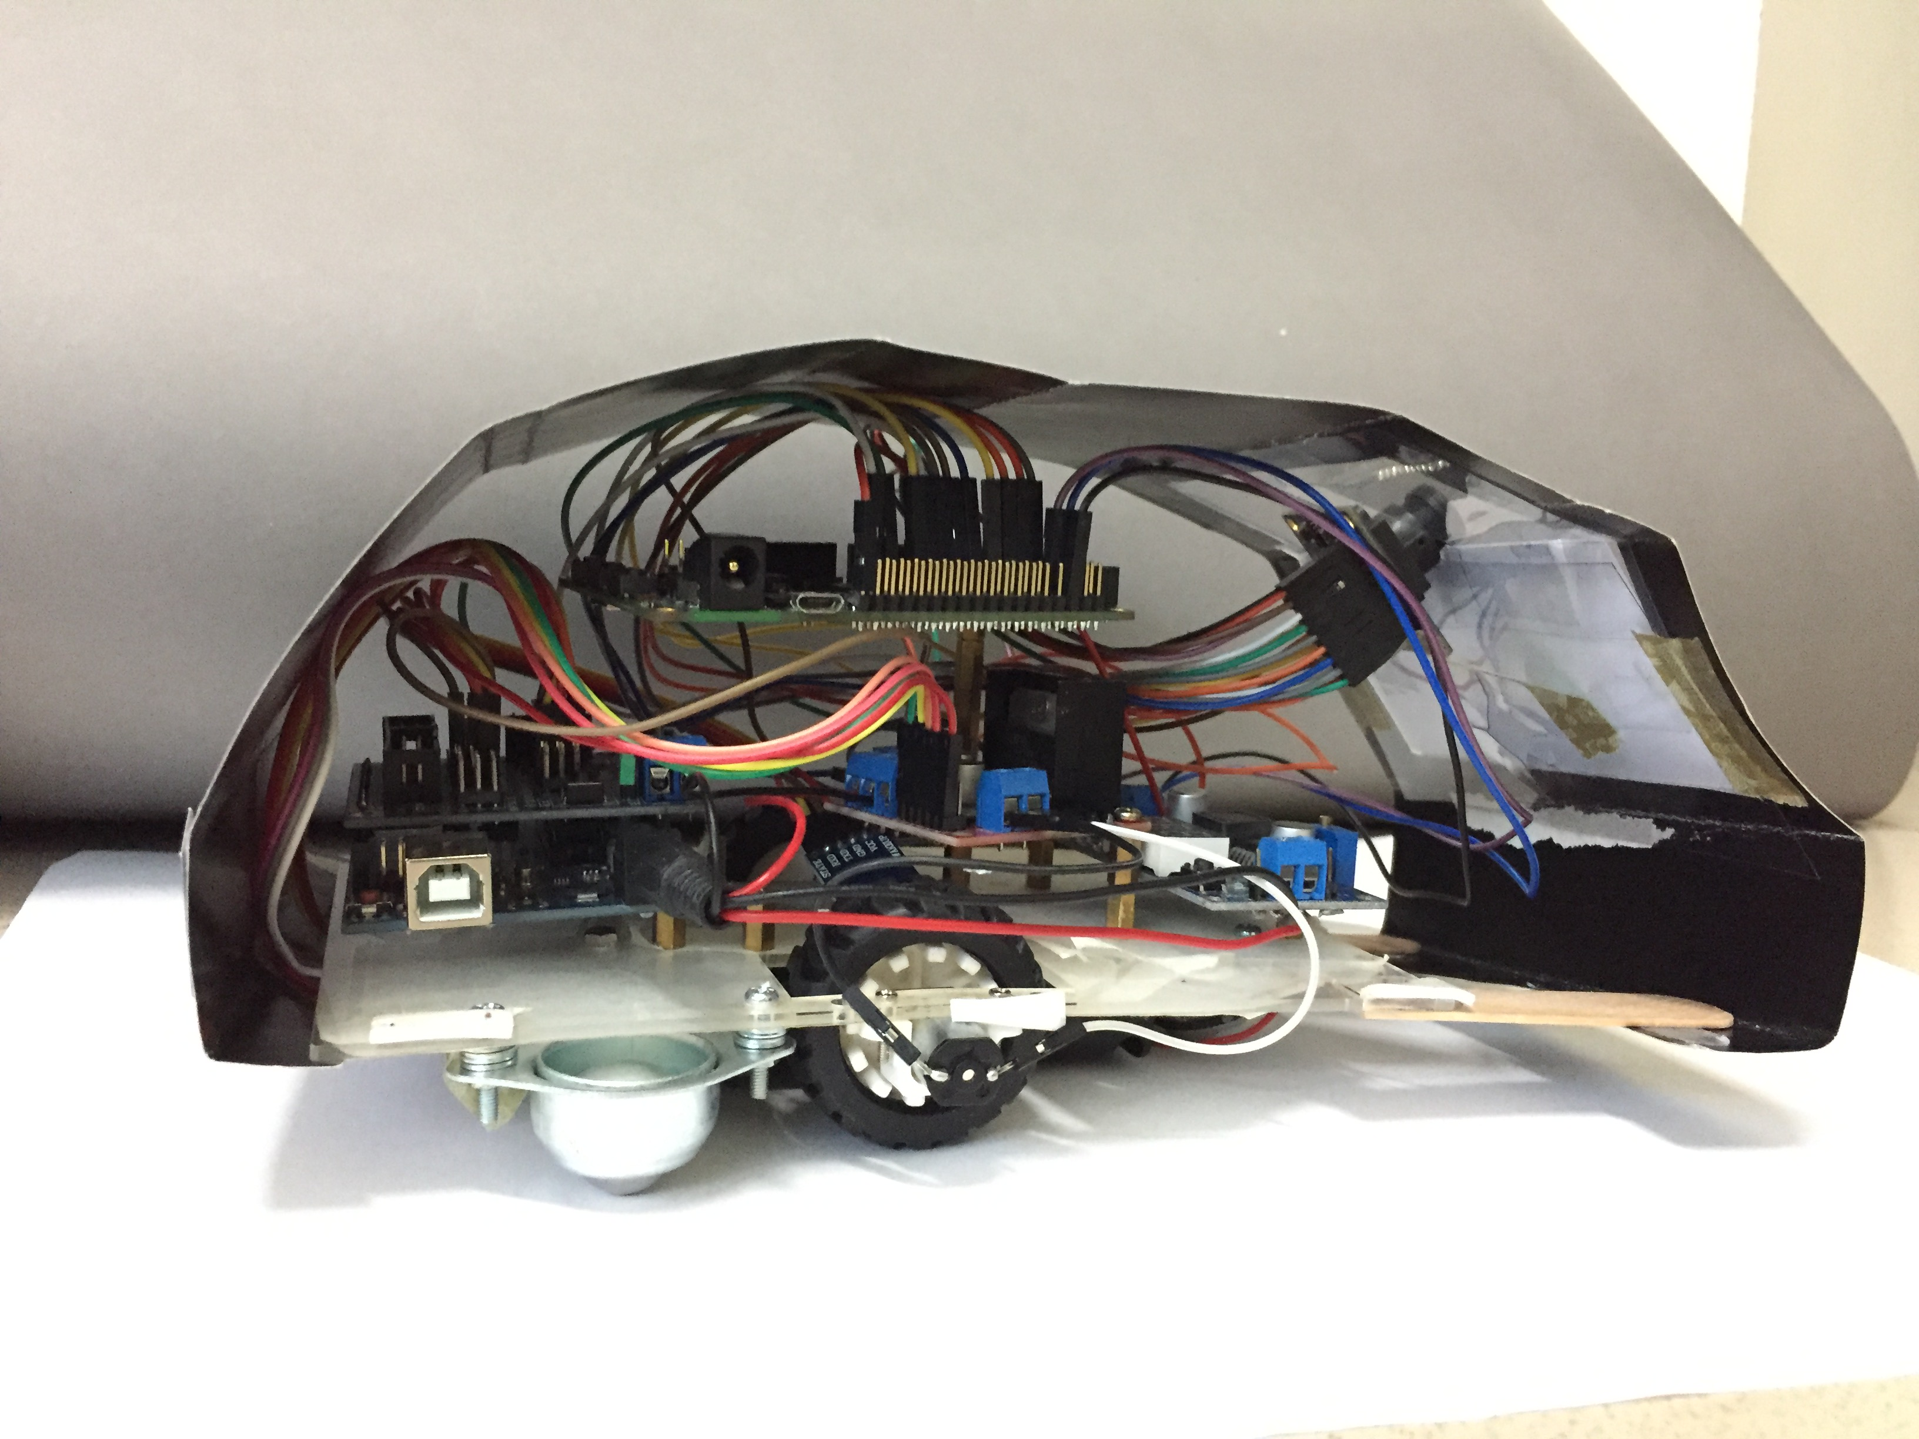
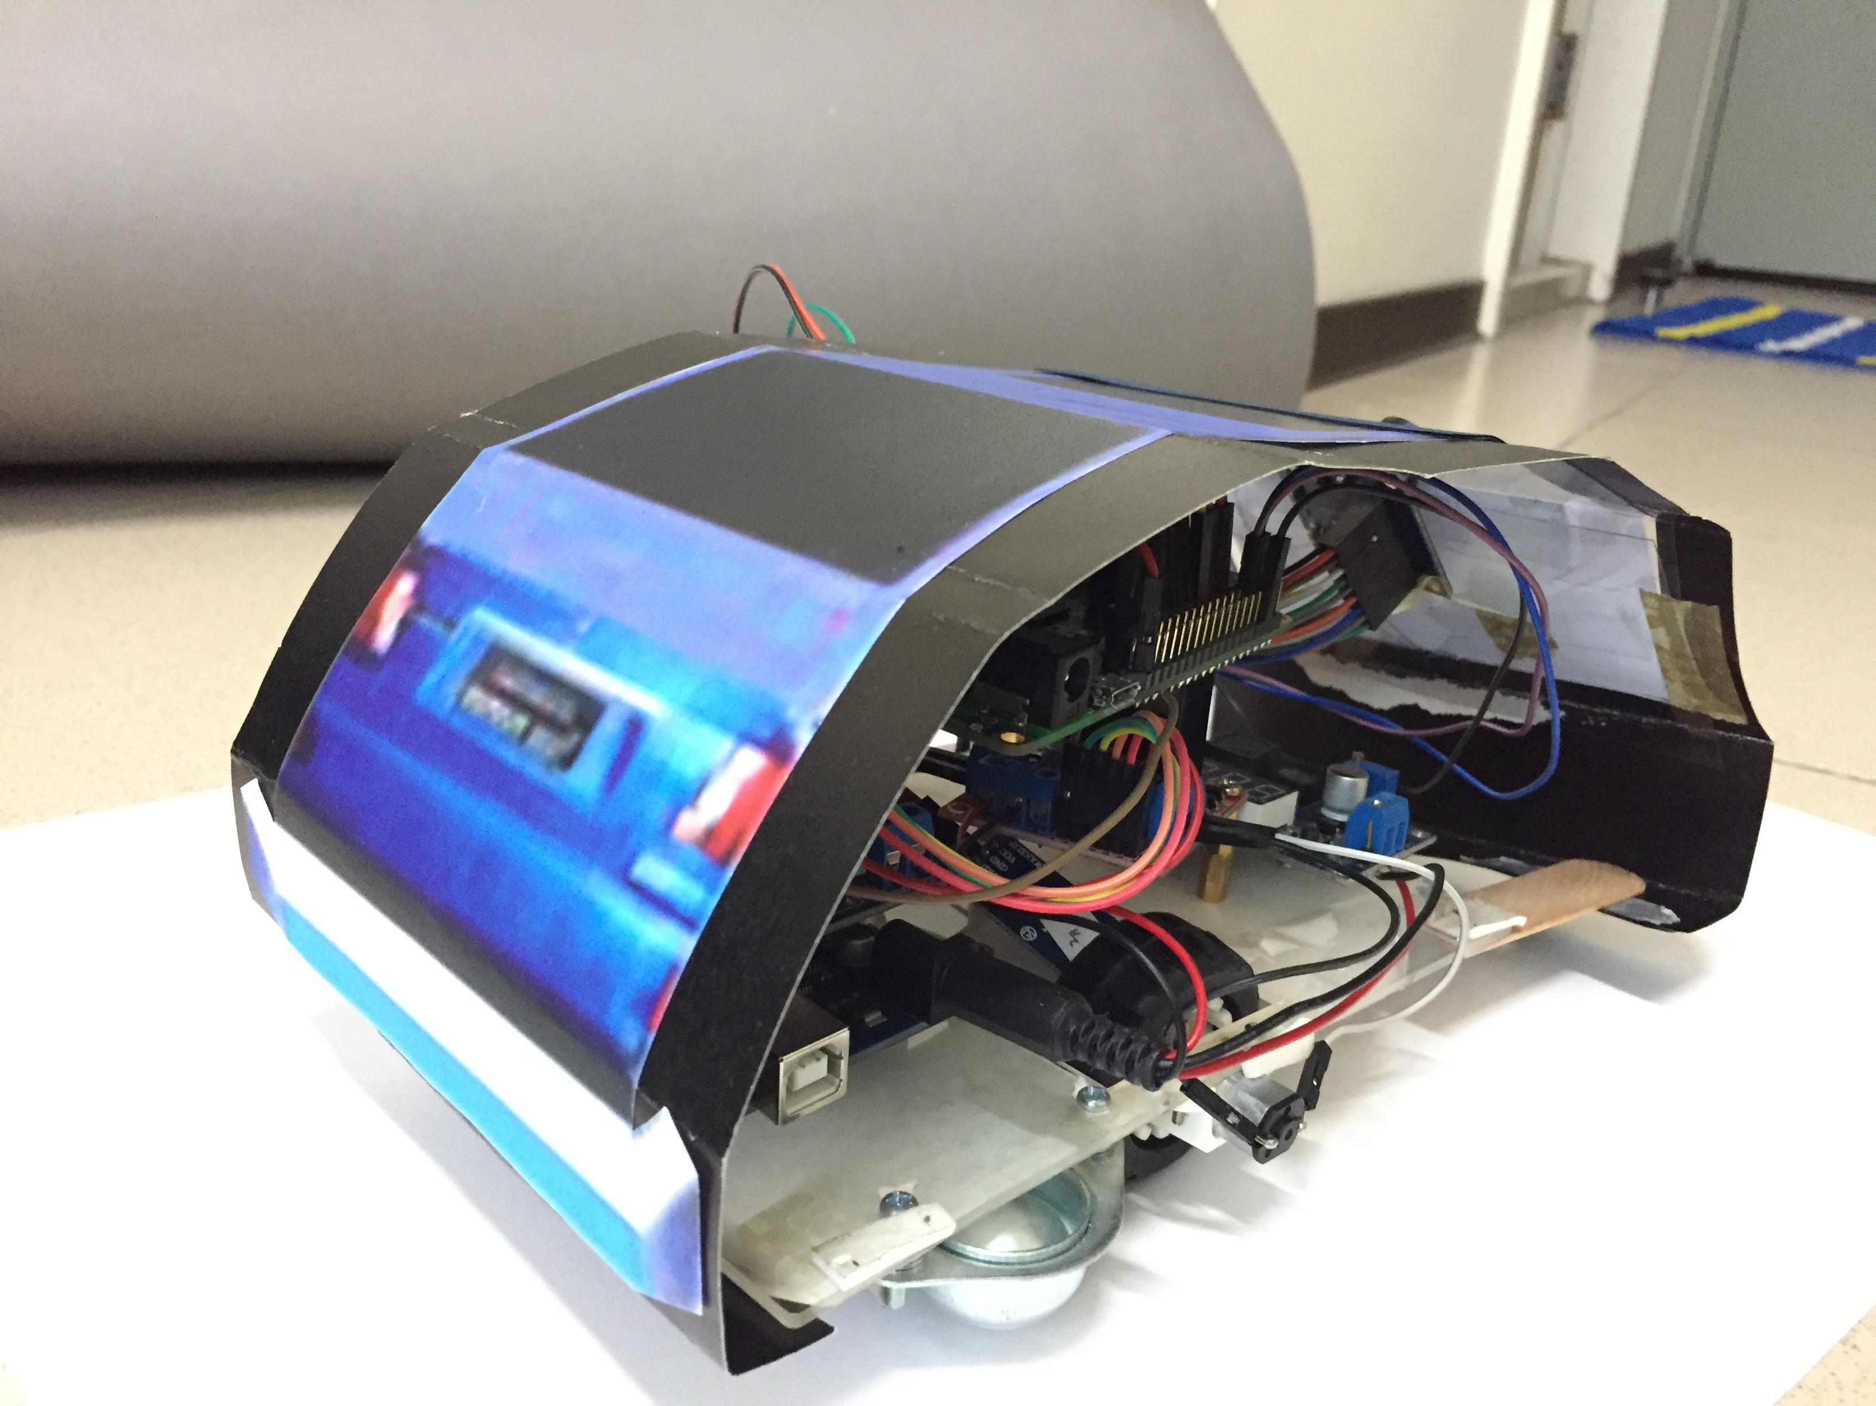
iRobot & Urban Scene

Slide 22
Agenda
Introduction
Technology Breakthrough
Results
Conclusion
Appendix
References

Slide 23
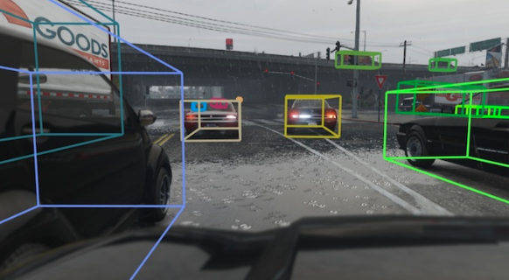
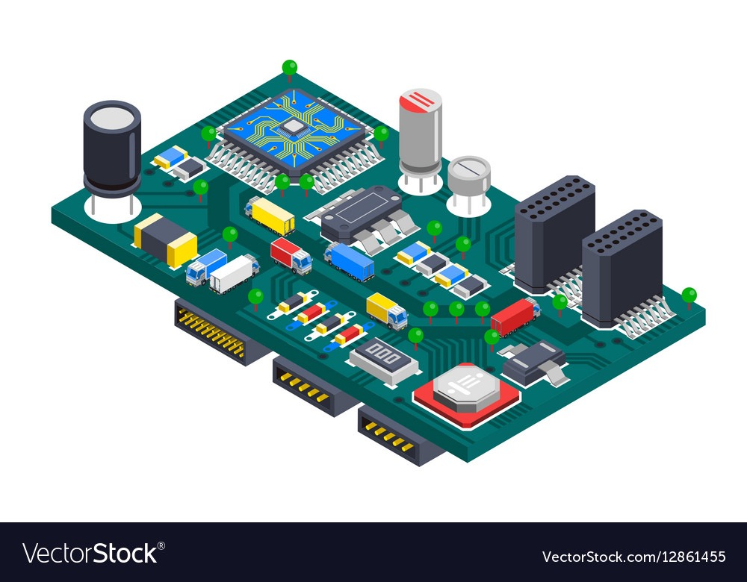
Conclusion
Notes:
Model Compression in Edge-Device
Realize Image Segmentation
Understand scenes
Self movement

Slide 24
Agenda
Introduction
Technology Breakthrough
Results
Conclusion
References
Appendix

Slide 25
References
Zhao, Hengshuang, et al. "Icnet for real-time semantic segmentation on high-resolution images." Proceedings of the European Conference on Computer Vision (ECCV). 2018.
He, Kaiming, et al. "Deep residual learning for image recognition." Proceedings of the IEEE conference on computer vision and pattern recognition. 2016.
Amazon Robotics
OV7670 Datasheet
https://singularityhub.com/2017/02/10/how-robots-helped-create-100000-jobs-at-amazon/

Slide 26
Agenda
Introduction
Technology Breakthrough
Results
Conclusion
References
Appendix

Slide 27
Introduction to OV7670
OV7670 is a low-power CMOS image sensor
Low operating voltage for embedded devices
Configurable through Serial Camera Control Bus (SCCB) interface, which is similar to I2C
Supports multiple color formats e.g., RGB565/555, YUB, and YCbCr

Slide 28
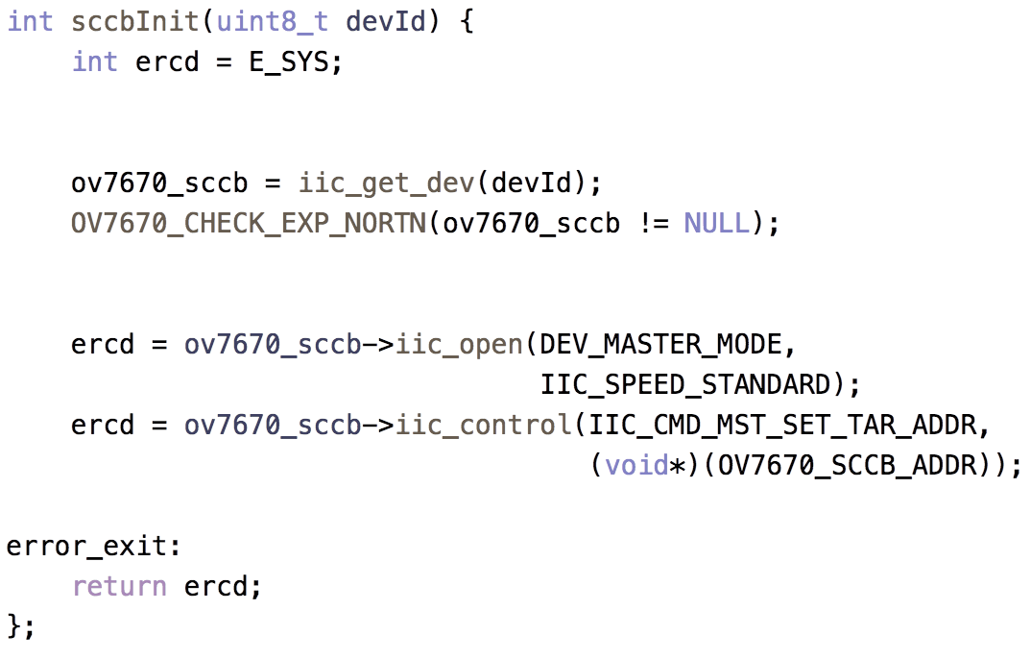
Using OV7670 with ARC IoT Kit
The SCCB protocol is similar to I2C
Initializing SCCB interface using embARC library
▼ Get I2C device ID
▼ Open I2C as master mode

Slide 29
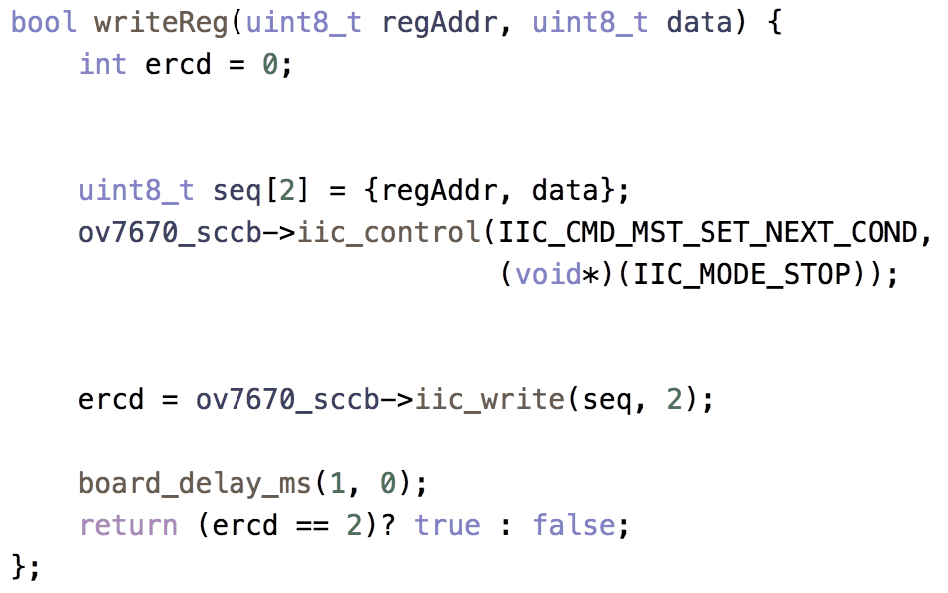
Using OV7670 with ARC IoT Kit
Write registers through SCCB
▼ Send STOP after I2C write
▼ Write address and data using embARC I2C functions

Slide 30
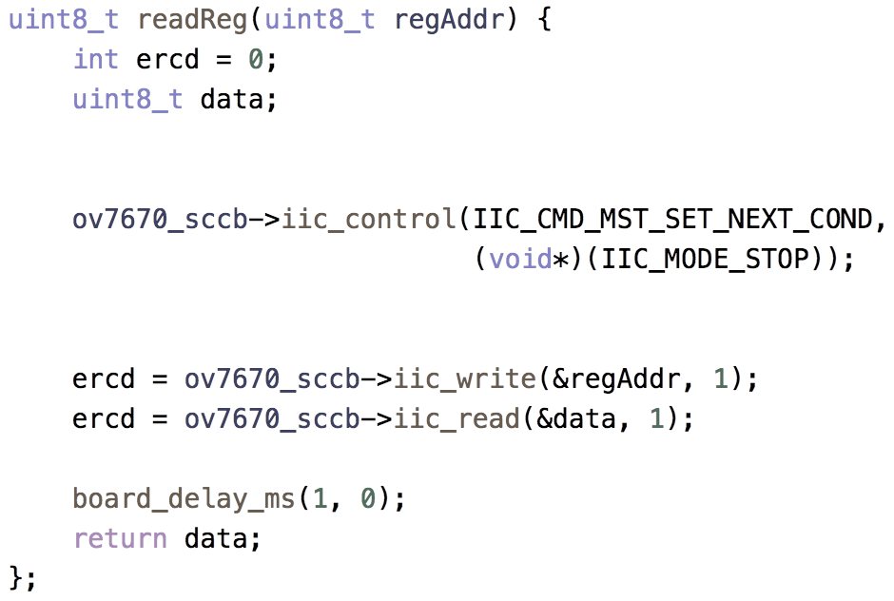
Using OV7670 with ARC IoT Kit
Read registers through SCCB
▼ Send STOP after write address and read data
▼ Write address, then read data from the address

Slide 31
Using OV7670 with ARC IoT Kit
Differences between I2C and SCCB read access
I2C
SCCB
▼ Send RESTART after writing address and STOP after data read
▼ Always send STOP after writing address or data read

Slide 32
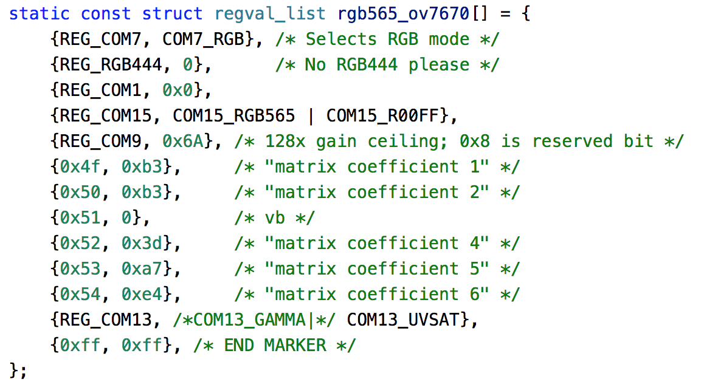
Using OV7670 with ARC IoT Kit
Camera initialization process
OV7670 configurations from the documentation

Slide 33
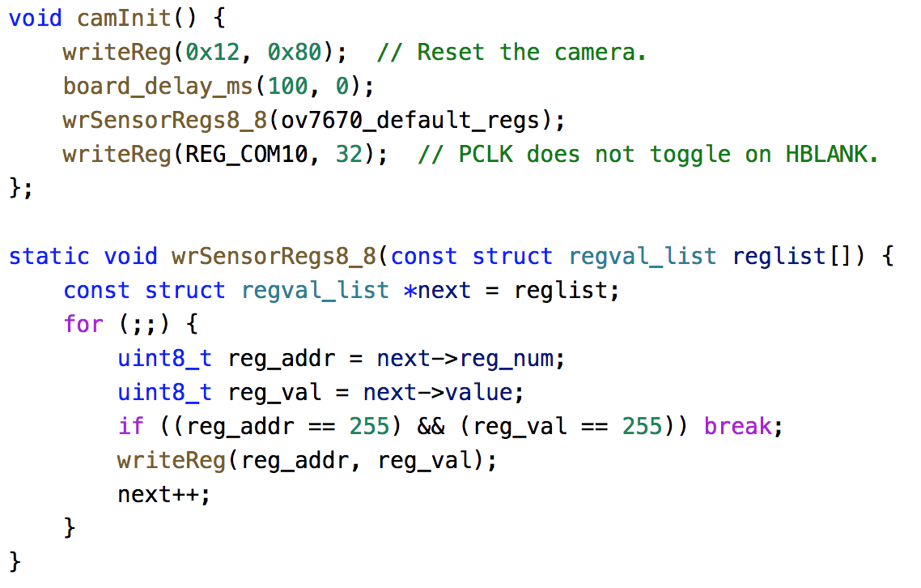
Using OV7670 with ARC IoT Kit
Camera initialization process
Writing configurations to OV7670 for initialization
▲ Using our writeReg() function to write configuration values

Slide 34
Using OV7670 with ARC IoT Kit
Generating clock for OV7670
Clock frequency 24M Hz

Slide 35
Using OV7670 with ARC IoT Kit
Reading camera pixel clock and data
At each pixel clock (PCLK) edge, we can read in pixel values from GPIO pins
However, PCLK is too fast for GPIO function calls
We use macro _arc_aux_read() in embARC to handle PCLK

Slide 36
Using embarc_mli library
Extract model coefficients
Define integer and fraction bits per layer
Define weight and bias size of each convolution layer
const w_type _W L1_conv_wt_buf[CONV1_W_ELEMENTS] = {
L1_WQ(-0.27608082),L1_WQ(0.1392435),L1_WQ(0.24875988),L1_WQ(-0.29018065),\
L1_WQ(0.000143734),L1_WQ(0.024988562),L1_WQ(-0.08530177),L1_WQ(0.16210964),\
#define CONV1_W_INT (0)
#define CONV1_B_INT (0)
#define CONV1_OUT_INT (4)
#define CONV1_W_FRAQ (FRQ_BITS(CONV1_W_INT, w_type))
#define L1_WQ(val) QMN(w_type, CONV1_W_FRAQ, val)
#define CONV1_W_SHAPE {32,3,3,3}
#define CONV1_W_ELEMENTS (32*3*3*3)
#define CONV1_B_SHAPE {32}
#define CONV1_B_ELEMENTS (32)

Slide 37
Using embarc_mli library
Define layers' configuration
Construct the model with functions in mli_kernal_api and mli_helpers_api
mli_krn_conv2d_chw_fx8
mli_krn_maxpool_chw_fx8
mli_krn_eltwise_add_fx8
Data preprocessing and model inference
seg_preprocessing( img, seg_net_input)
seg_net()
static const mli_conv2d_cfg shared_conv_cfg = {
.stride_height = 1, .stride_width = 1,
.padding_bottom = 1, .padding_top = 1,
.padding_left = 1, .padding_right = 1,
.relu.type = MLI_RELU_GEN
};

